Slide 1
Managing Human Capital in Retail
Development and Retention Introduction
Matthew Bidwell, Associate Professor of Management

Slide 2
Development and Retention Overview
Why and why not to train
Keys to effective learning
The costs and causes of attrition
Approaches to increasing retention

Slide 3
Managing Human Capital in Retail
Why Train: Firm Specific Skills
Matthew Bidwell, Associate Professor of Management

Slide 4
Skills and Training
Firm Specific Skills
General Skills
Definition
Knowledge and skills that are only useful within a single organization
Knowledge and skills that are only useful across organizations
Costs
Employee time in training
Development of training materials
Trainer time
Benefits
Understanding of core processes and technology
Knowledge of products
Exposure to organizational culture

Slide 5
Managing Human Capital in Retail
Why Train: General Skills
Matthew Bidwell, Associate Professor of Management

Slide 6
Skills and Training
Firm Specific Skills
General Skills
Definition
Knowledge and skills that are only useful within a single organization
Knowledge and skills that are only useful across organizations
Costs
Employee time in training
Development of training materials
Trainer time
Employee time in training
Development of training materials
Trainer time
Risk of increased attrition
Need to increase pay
Benefits
Understanding of core processes and technology
Knowledge of products
Exposure to organizational culture
Secure scarce skills
Create unusual combinations of skills and attributes
Foster internal promotion
Build loyalty

Slide 7
Managing Human Capital in Retail
Keys to Effective Learning
Matthew Bidwell, Associate Professor of Management

Slide 8
How People Learn
Advantages
Considerations
10%
Formal Instruction
Scalable
Consistent
Frequent revisiting/building on prior material
Promoting effortful recall
20%
Peer Learning
Critical for building culture and values
Requires bringing people together
More opportunities to share knowledge online
70%
Experiential
Learning
Provides detailed understanding of task performance
Fills in contextual details
Enhanced by struggling with complex challenges
Associated with low initial performance
Requires feedback and reflection
Major role for coaching to ensure right lessons are learned

Slide 9
Managing Human Capital in Retail
Costs of Attrition
Matthew Bidwell, Associate Professor of Management

Slide 10
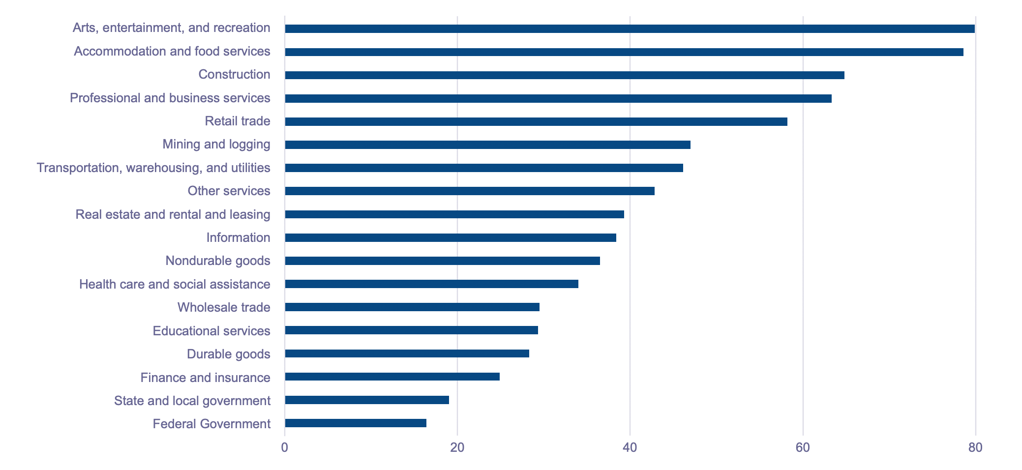
US Turnover by Industry, 2019

Slide 11
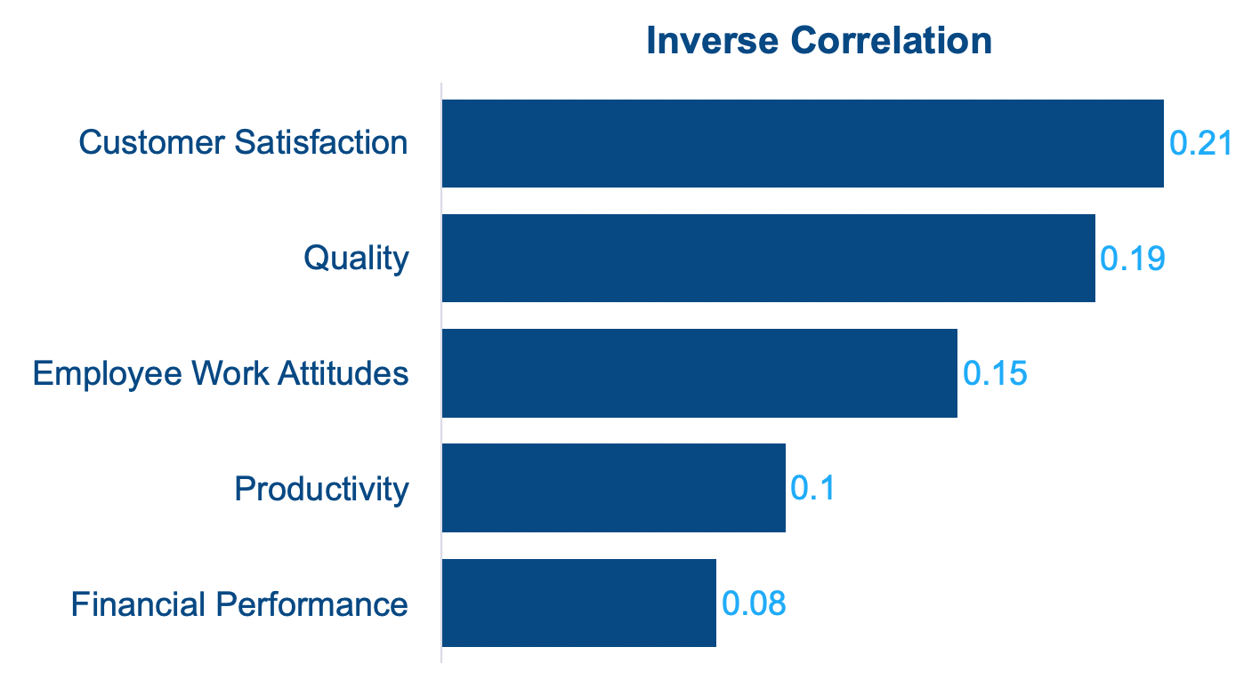
What is the Relationship Between Turnover and Performance?
Park and Shaw 2012; Shaw, Park & Kim 2012

Slide 12
Managing Human Capital in Retail
Causes of Attrition
Matthew Bidwell, Associate Professor of Management

Slide 13
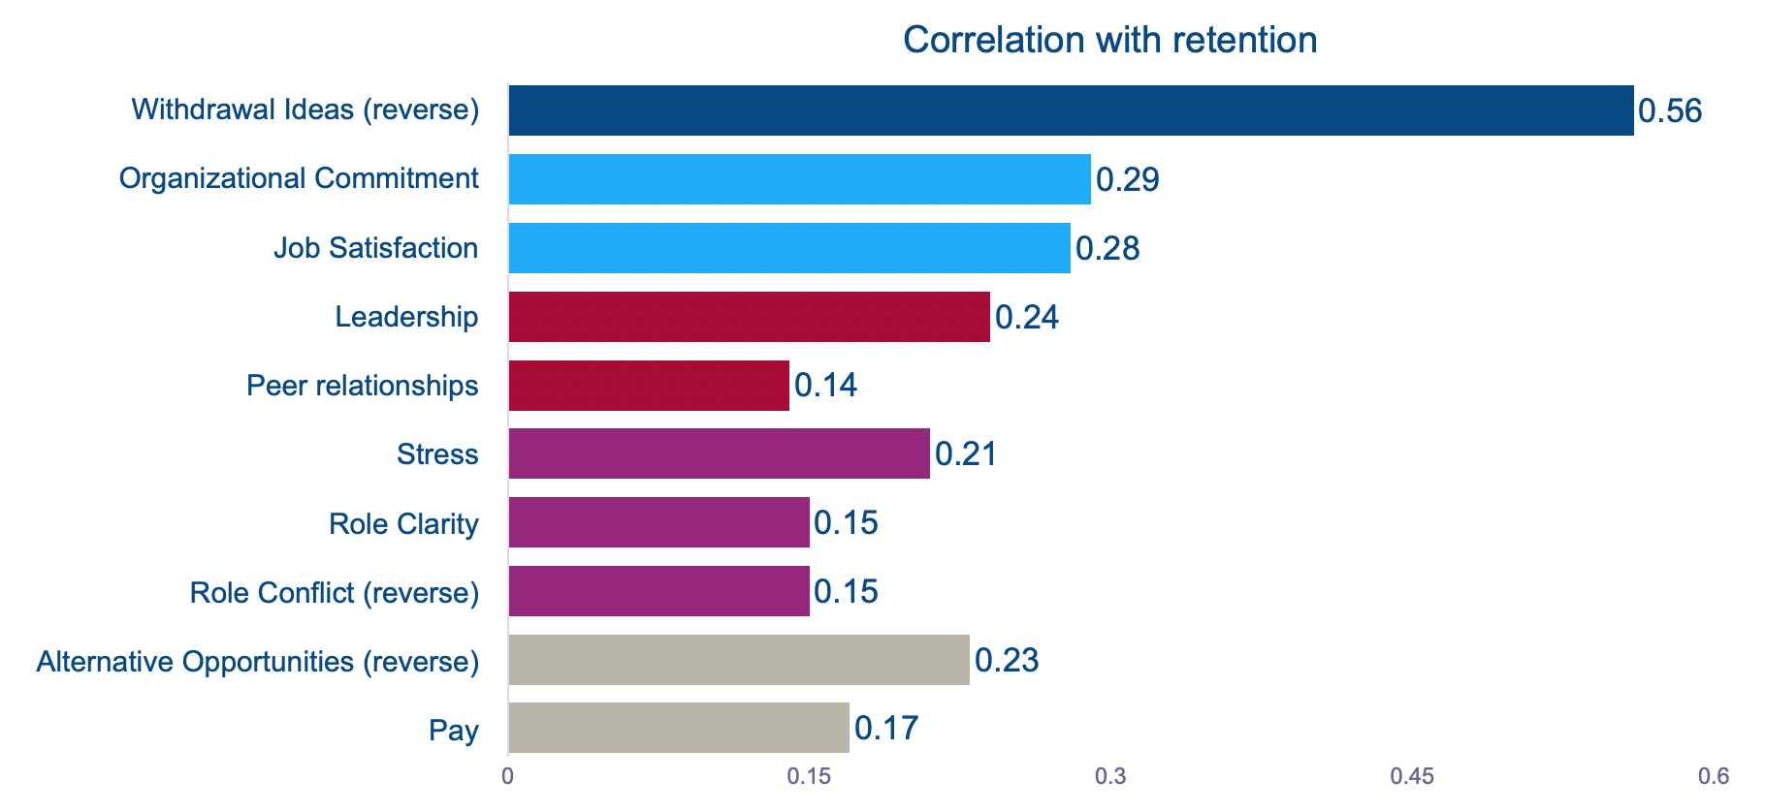
Who Leaves?
Rubinstein, Eberley, Lee, Mitchell

Slide 14
What Changed?
Perception of their fit with job
Negative feedback/event
Increase in skills/aspirations
Increased availability of alternatives

Slide 15
Managing Human Capital in Retail
Strategies for Retention
Matthew Bidwell, Associate Professor of Management

Slide 16
What Changed?
Perception of their fit with job
Improved selection
Realistic job preview
Job design
Negative feedback/event
Effective onboarding
Management training
Increase in skills/aspirations
Internal career paths
Increase availability of alternatives
Review of employee offering/USP
Back-loaded compensation and training

Slide 17

Effectiveness of Onboarding
Focusing on your strengths
Integrating new workers into formal work
Study in Indian call center gave newcomers one hour training focused on understanding what made them happiest at work and what they did best
Rate of turnover was reduced by almost ½ relative to traditional onboarding
Study in Indian garment factories examines differences in initial training based on experience of training
Rates of 3 month retention are 50% higher for experienced trainers
Cable, Gino, Staats 2013; Ranganathan 2018

Slide 18
Summary
Pros and cons of training
Attrition has a cost
Importance of having a strategy for retention

Slide 19


